Slide 1

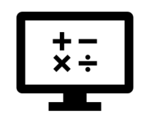
Interoperability
Where do I find MATLAB? Here!
Do I have to have MATLAB installed on my computer right now? No, you can use MATLAB Online!

Slide 2

Table of Contents
Recap of Week 6, Part 1: Big Picture
MATLAB Interoperability with other languages
MATLAB and Python
What we've covered this week in part 2: Interoperability
Extra resources
References
MATLAB Live Script

Slide 3
Recap of Week 6, Part 1: Big Picture
This week in part 1, we learnt about:
What is computational thinking?
Why is computational thinking important?
How do we become computational thinkers?
In the next part of this week's content, we will be learning about interoperability, covering the following sub-topics:
Interoperability with other languages
MATLAB and Python

Slide 4
MATLAB Interoperability with other languages
Interoperability is the ability of computer systems or software to exchange and make use of information. MATLAB offers interoperability between many other languages, as well as three means of achieving this:
Call libraries written in another language from MATLAB
Call MATLAB from another language
Package MATLAB programs as software components for use in other languages

Slide 5
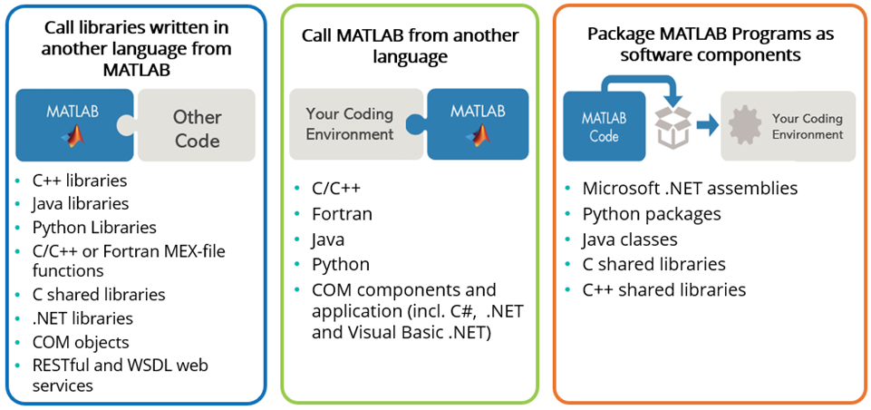
MATLAB Interoperability with other languages
The following graphic covers each of these in more details, but we encourage you to consult this link for more information on using MATLAB with other languages.

Slide 6
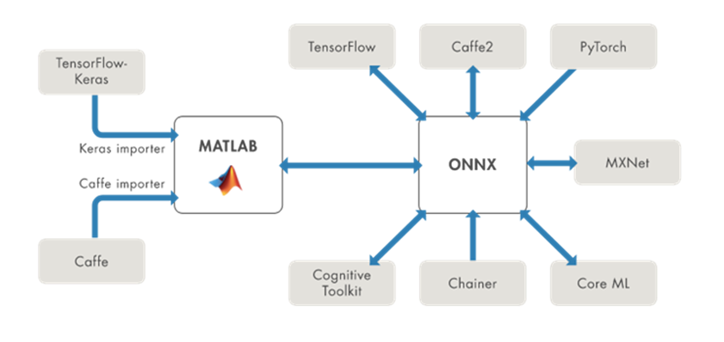
MATLAB Interoperability with other languages
You can also leverage open architecture formats in your workflow. The ONNX model format is one such example, where importing and exporting of Deep Learning models in MATLAB (and consequently Simulink) enables cross-tool development, testing, and deployment. See the Deep Learning Import and Export documentation for more information on this.

Slide 7
MATLAB and Python
For the remainder of this section, we will be covering a basic call of Python from the MATLAB environment. If you already have Python installed, be sure to check if the version interfaces with MATLAB by consulting this link. For Python installation support, please consult the Configure Your System to Use Python documentation. Be sure install a version that can interface with MATLAB.
Note: You can always use MATLAB Online for working with Python in MATLAB. This environment has already been configured for your ease of access.
Assuming you are all setup and ready to move forward, let us do a quick check with MATLAB what version of Python is recognising. We use the command pyenv (or pyversion if you are using a MATLAB version prior to R2019b).
pyenv
The output from this command will supply you with the version of Python being recognised, for example 3.9. If you receive an empty string response for the Version, MATLAB is not recognising your Python installation and you should check that a compatible version is installed correctly. You may need to Install MATLAB Engine API for Python.

Slide 8
Use Python Numeric Types in MATLAB
When calling a Python function that takes a numeric input argument, MATLAB converts double values into types that best represent the data to the Python language. For example, to call trigonometry functions in the Python math module, pass a MATLAB double value.
pynum = py.math.radians(90)
pynum = 1.570796326794897
For functions that return Python float types, MATLAB automatically converts this type to double.
class(pynum)
ans = 'double'

Slide 9
Use Python Numeric Types in MATLAB
For Python functions returning integer types, MATLAB automatically converts this type to int64. For example, the bit_length function returns the number of bits necessary to represent an integer in binary as an int value.
py.int(intmax).bit_length
ans =
Python int with properties:
denominator: [1×1 py.int]
imag: [1×1 py.int]
numerator: [1×1 py.int]
real: [1×1 py.int]
31

Slide 10

Use Python Numeric Types in MATLAB
Now you try! Create a row vector, x, with the value 2, 4, and 6, and use fsum from the Python math module to determine its sum.
x = 2:2:6;
py.math.fsum(x)
ans = 12

Slide 11
More resources:
For more information on how to call Python from MATLAB or MATLAB from Python, watch the following video tutorial:
Video tutorial: How to Call Python from MATLAB
Video tutorial: How to Call MATLAB from Python
You can also consult the Cheat Sheets for Using MATLAB with Python for getting started.

Slide 12
What we've covered this week in part 2: Interoperability
This week in part 2, we learnt about:
Interoperability with other languages
MATLAB and Python
In the next part of this week's content, we will be demonstrating Beyond Introduction to Programming, covering the following sub-topics:
Symbolic Math
Object-Oriented Programming (OOP)
Simulink

Slide 13
Extra resources
Documentation: MATLAB Interfaces to Other Languages
Video: Interoperability of MATLAB with other Programming Languages
Cheat Sheets for Using MATLAB with Python
Self-Paced Online Courses

Slide 14
References
Using MATLAB with Other Programming Languages
Documentation: Use Python Numeric Variables in MATLAB
Video tutorial: How to Call Python from MATLAB
Video tutorial: How to Call MATLAB from Python
Copyright 2022 The MathWorks, Inc. & Opti-Num Solutions (Pty) Ltd.

Slide 15
MATLAB Live Script
Click on the link below for this lecture’s MATLAB live Script
Week_6_Part_2_Interoperability_Solution.mlx

